Slide 1
Constructing Gene Co-Expression Networks for Gene Function Prediction
Final project - Programming for Data Science
Milica Aleksić
70m/18

Slide 2
Motivation
problem:
solution (one of):
A lot of newly
sequenced genes with
unknown functions
Building co-expression networks
= Genes with similar expression patterns are connected into a graph
idea:
Gene expression
- Genes → RNA → Proteins
- Different temporal and spatial control → DIFFERENT FUNCTION

Slide 3

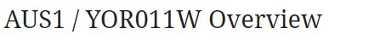
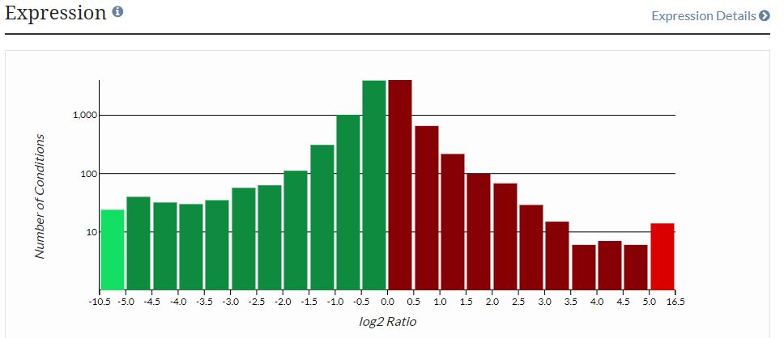
Data
SGD – comprehensive information about budding yeast genes, proteins, and other encoded features
Expression profiles
1799 genes
740 experiments (conditions)

Slide 4
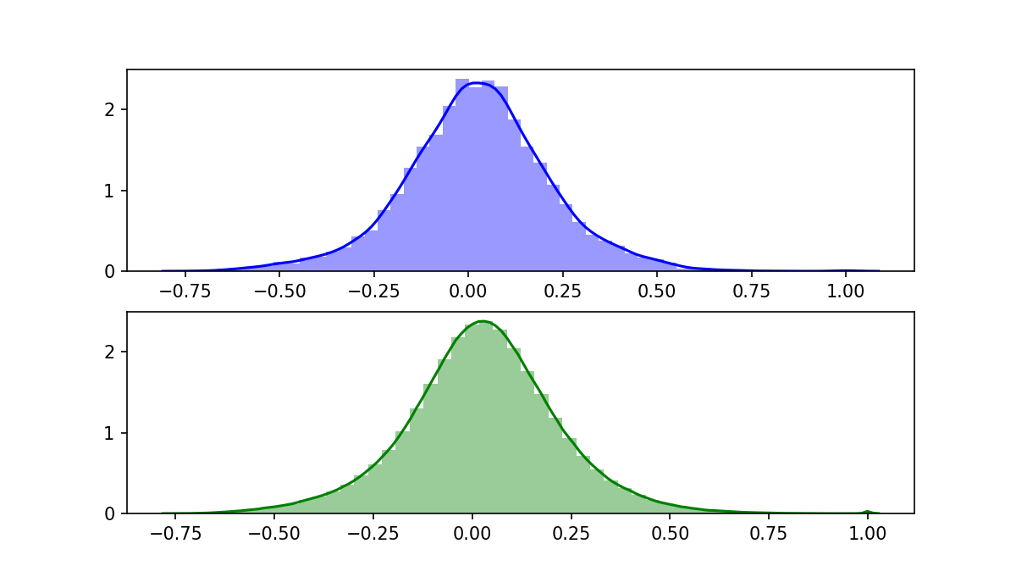
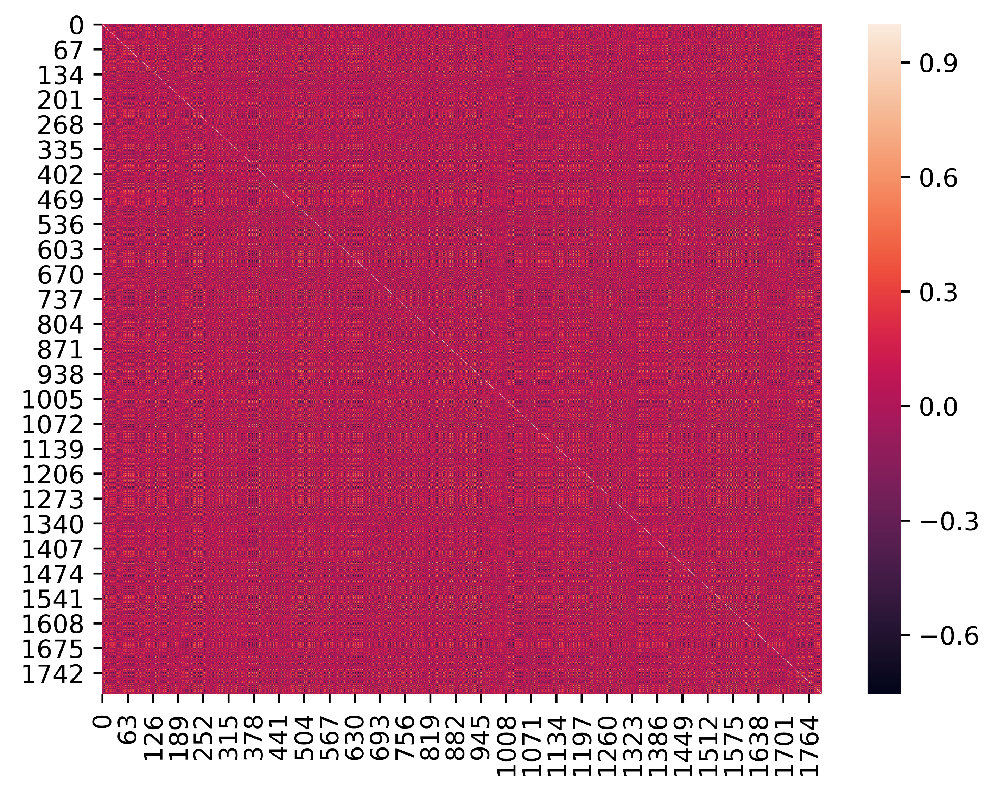
Step 1: Computing correlation between genes
Removing the noise:
1. calculate correlations of randomly selected genes (green)
2. repeat 10 000 times
3. take only values form 1st and 99th percentile
Pearson correlation between genes:

Slide 5
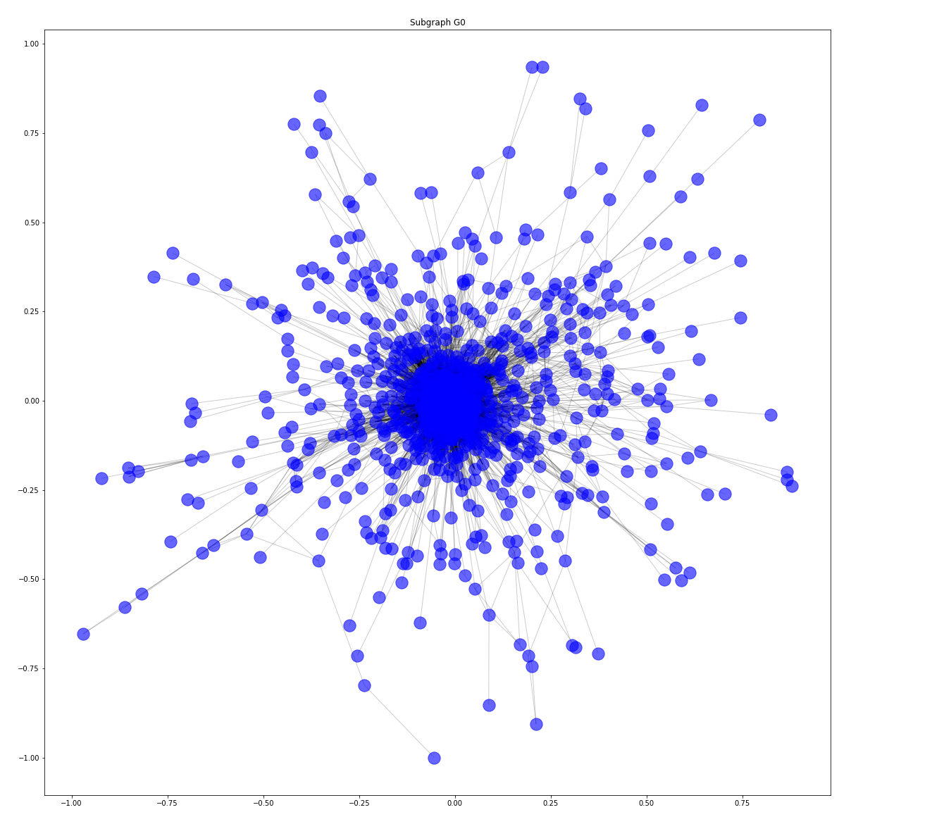
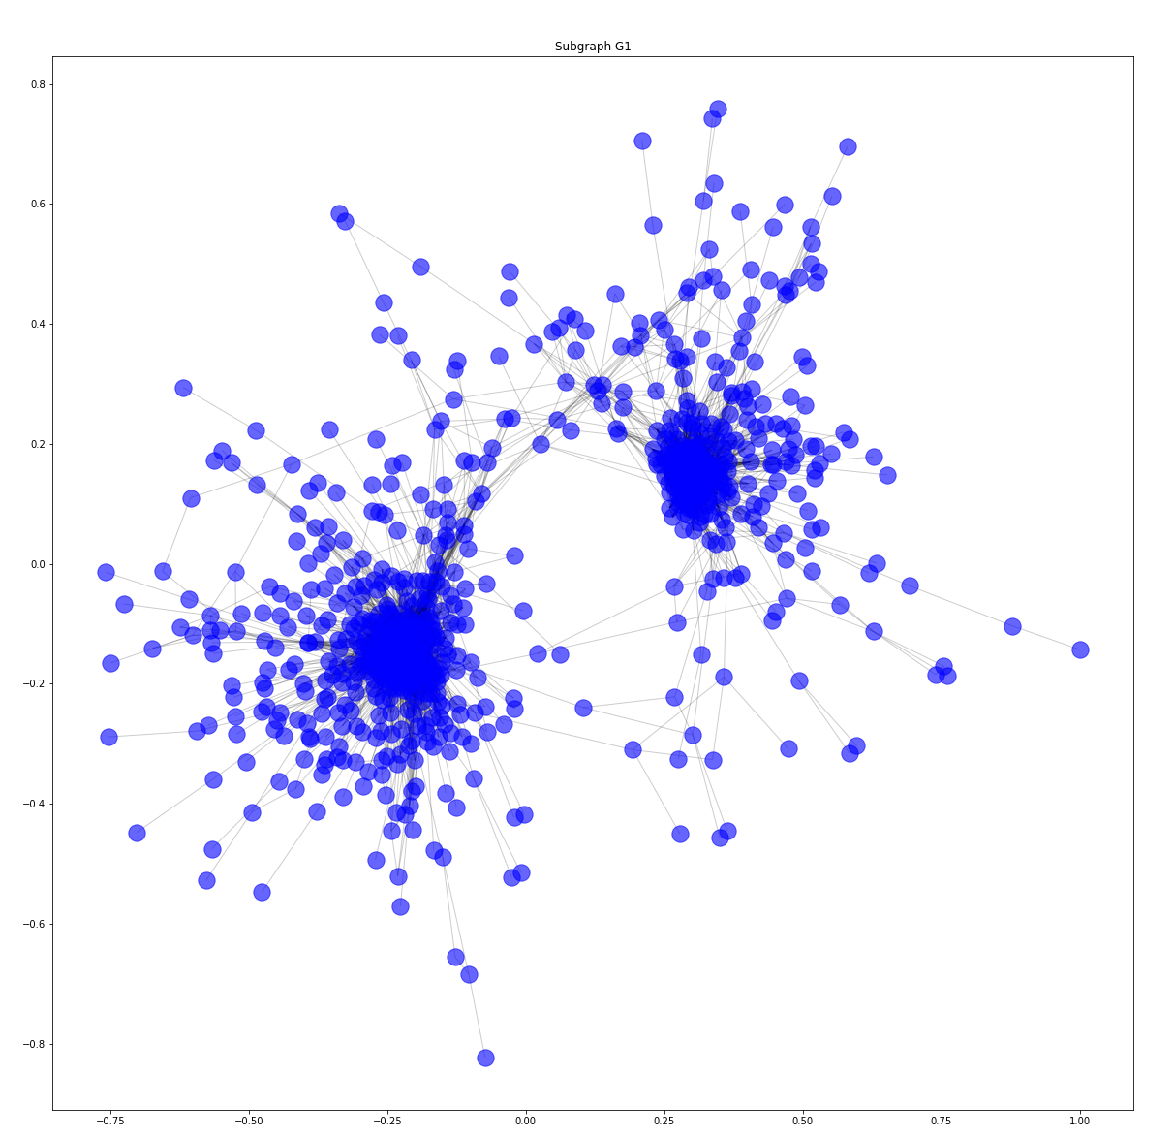
Step 2: Creating a co-expression network
= weighted graph with genes as nodes and edges as a representation of correlation greater/smaller than threshold

Slide 6
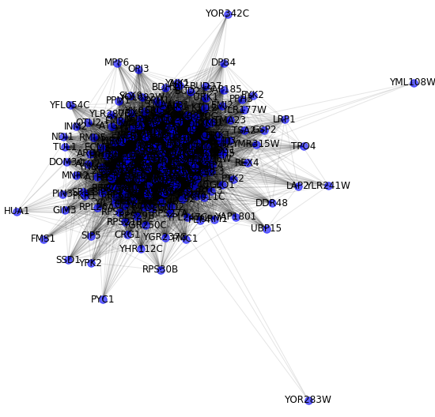
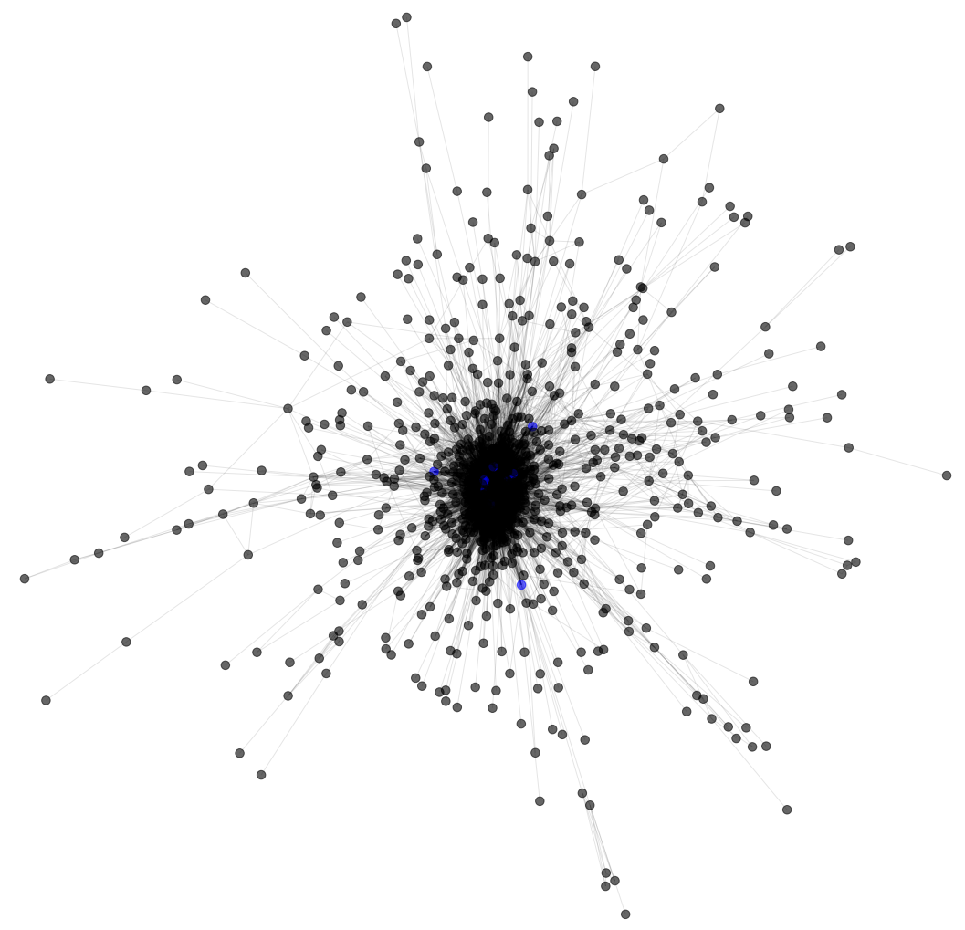
Step 3: Analyze graph local properties
Ego graph of gene MRI1 (10th node with highest betweenness centrality)
Biggest subgraph – 10 nodes in blue have the highest betweenness centrality

Slide 7
Step 4: Gene clustering
Affinity propagation clustering
based on the concept of "message passing" between data points
Number of clusters is not predefined
Parameters:
Precomputed – affinity matrix from step 1 (+ and – corrected correlation matrix)
Damping = 0.5
Maximum number of iterations = 300
Convergence iterations = 15
229 gene clusters
Average cluster size = 7.85,
Cluster size = 6

Slide 8
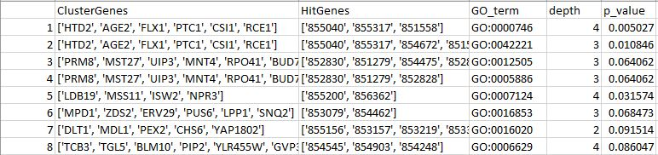
Step 5: Enrichment analysis
Gene ontology = controlled vocabulary of gene and gene products attributes
Orange (for enrichment) + mygene (accession conversion)
Each cluster was tested, only p<0.1 was considered:
88/229 clusters had a set of enriched terms
Average term depth: 4.34
Results are in the table form

Slide 9
Step 5: Enrichment analysis
Interesting example:
cluster genes: ['UBA4', 'RPS27A', 'RPL31B', 'RPS10A', 'MAM3', 'RPL35A', 'RPS29A', 'RPS30B', 'RMA1', 'RPS16B', 'RPL21B', 'PKP1', 'RPS28A', 'MOG1', 'ECM27', 'RPS21A', 'CHO2', 'RPL26A', 'RPS25B', 'RPS21B', 'RPS29B’]
enriched genes: ['RPS25B', 'RPL31B', 'RPL26A', 'RPS29B', 'RPS10A', 'RPS29A’, 'RPS16B', 'RPS21B', 'RPS28A', 'RPS30B', 'RPL21B', 'RPS27A’, 'RPL35A', 'RPS21A’]
term: cytoplasmic translation (BP, depth 7) - reactions and pathways resulting in the formation of a protein in the cytoplasm

Slide 10
Conclusions
Gene co-expression networks can be used (and are used) for gene annotation but need an evaluation mechanism

Slide 11
Ideas for future work
Analyze positive and negative correlation separately
Split enrichment analysis between BP, MF and CC ontologies, compare success
Compare clusters with graph
Use different clustering algorithm, or adjust the parameters of AP

Slide 12
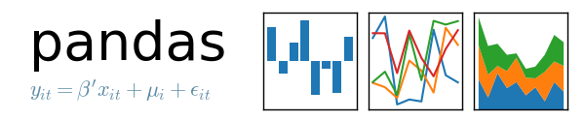
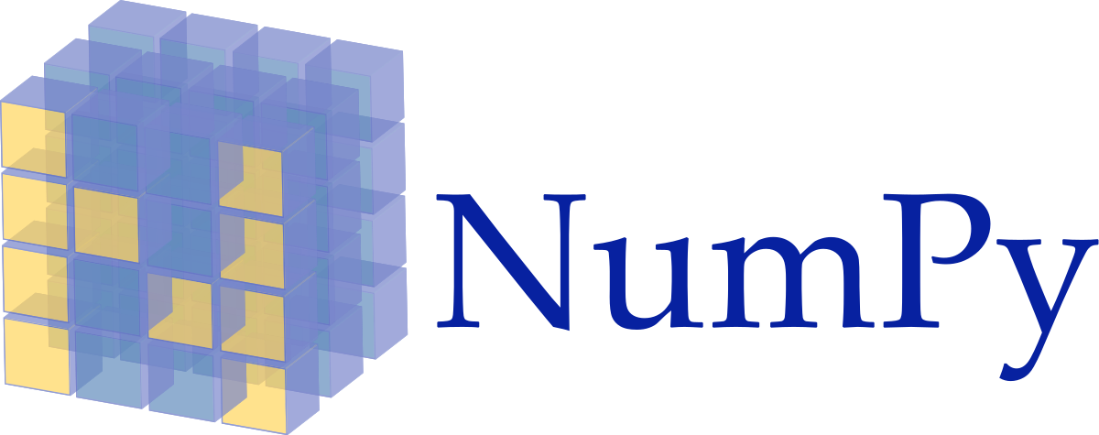




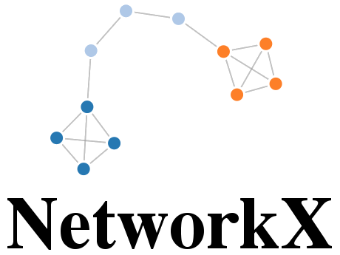
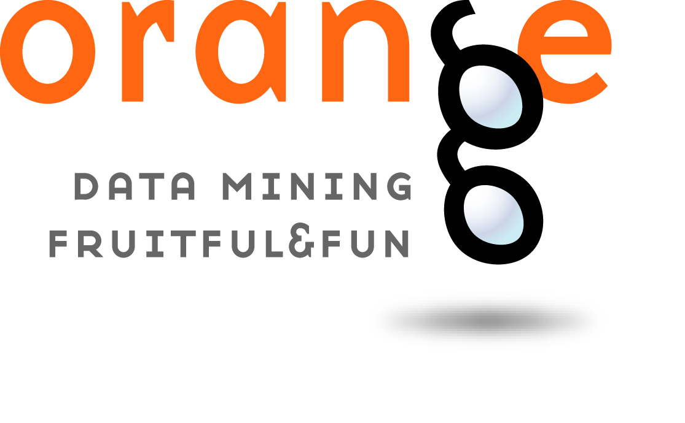

Implementation information

